Slide 1
State Design Pattern

Slide 2
State Pattern
It is a behavioural design pattern that allows an object to alter its behaviour based on changes to its internal state.
This object seems to ‘magically’ change.

Slide 3
Demo
We will take a simple example of a traffic light to understand this pattern.
The TrafficLight class changes the object it returns based on its internal state which is an object of Red, Yellow or Green class.

Slide 4
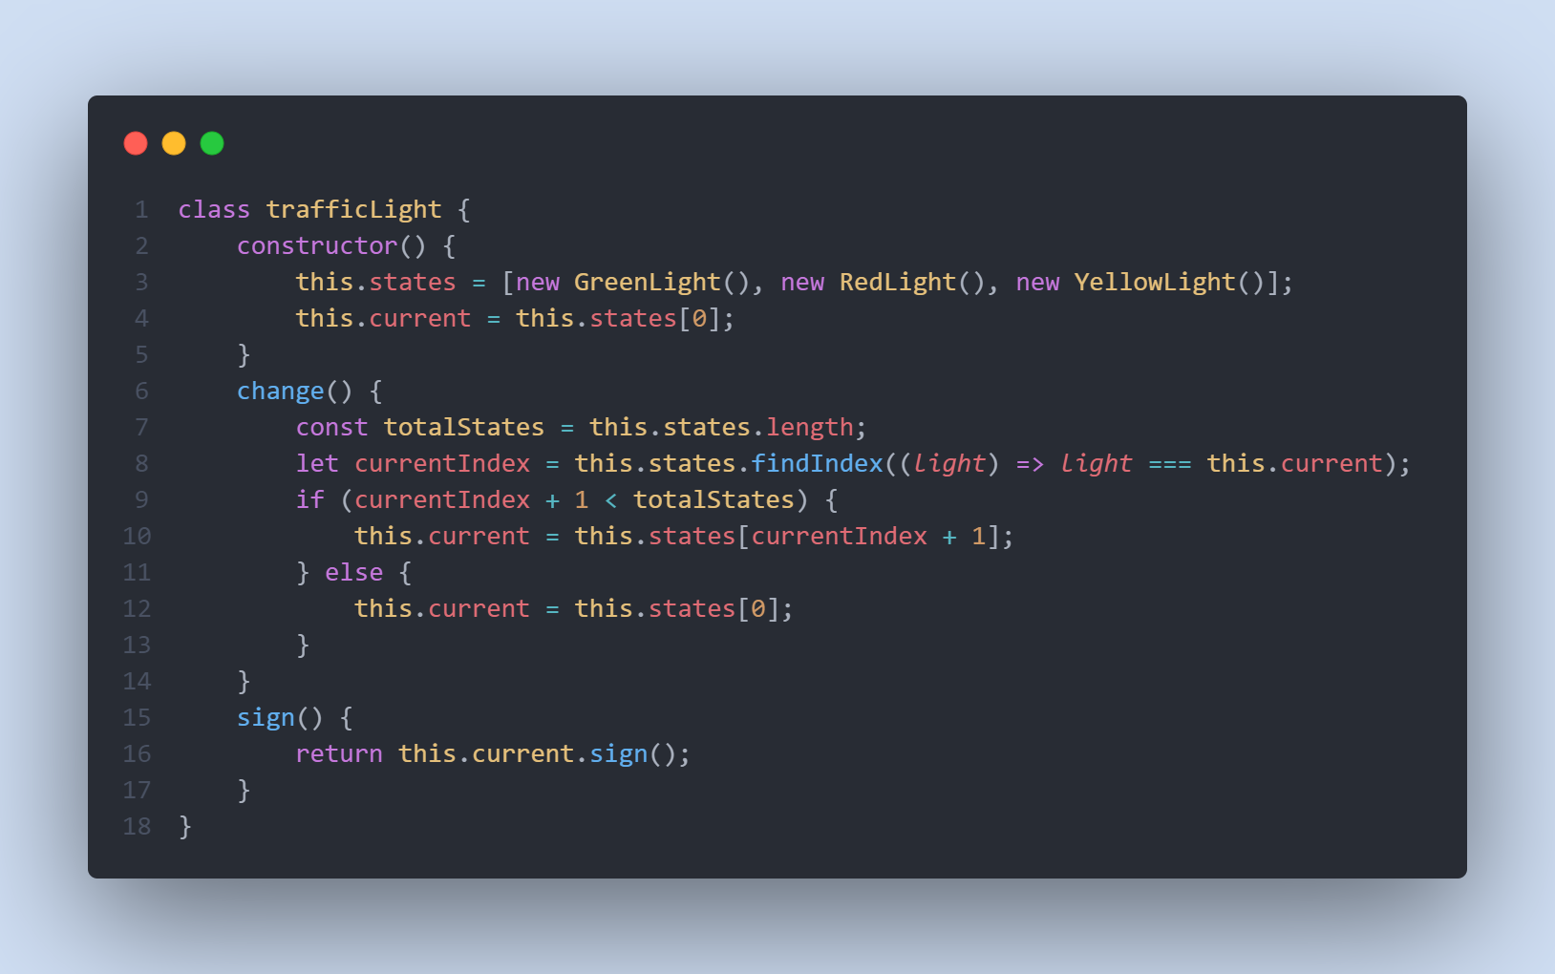

Slide 5
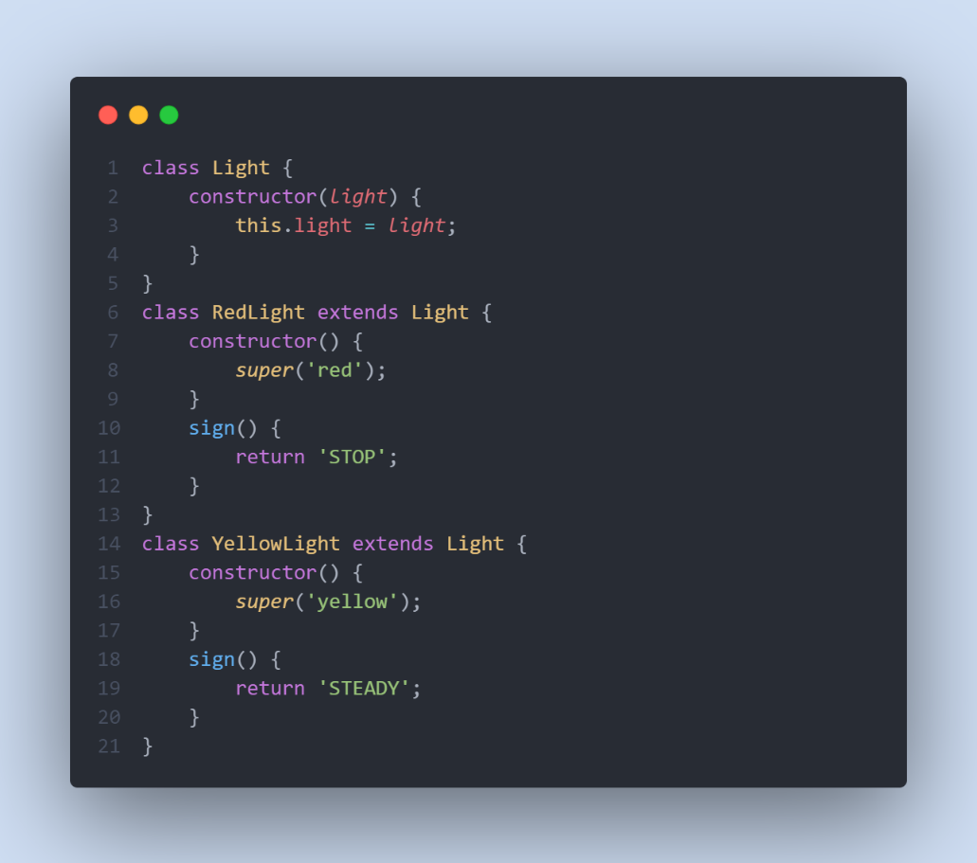

Slide 6
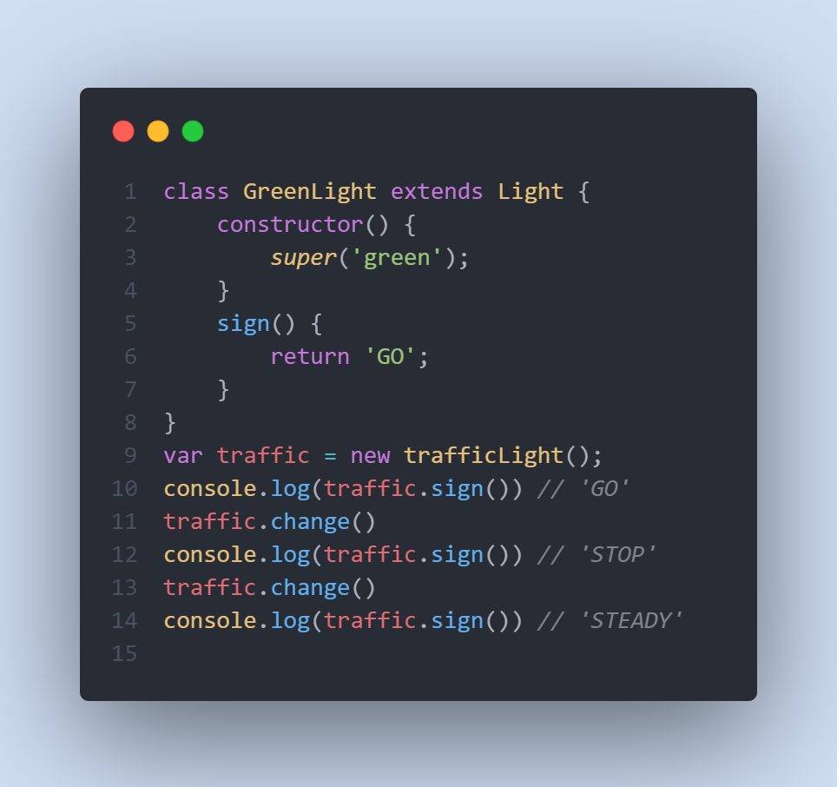

Slide 7
Reference
https://able.bio/drenther/javascript-design-patterns--89mv2af#state-pattern
https://www.geeksforgeeks.org/state-design-pattern/

Slide 8
THANKS!

